Slide 1


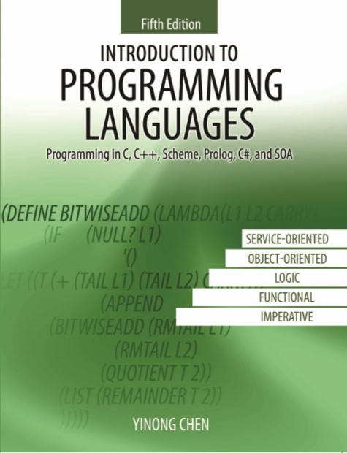
CSE240
Introduction to Programming Languages
Chapter 4
Functional Language
Scheme

Slide 2
CSE240
Introduction to Programming Languages
Chapter 4
Functional Language Scheme
Lecture 20
Getting Start with Scheme Programming
Reading: Textbook Sections 4.1, 4.2, and 4.3
Dr. Yinong Chen

Slide 3
Outline
Functional Programming Paradigm
Terminology
Some basic scheme procedures
Define your own procedures -- procedure definition
Scopes: global environment and local names
Programming with data structure
Recursion
Character and string
Symbols, pairs and lists
Modules and their interfaces

Slide 4
Review: Functional vs. Imperative Programming
Functional Programming Idea: liberate programming from von Neumann-style imperative languages.
Problems of imperative and OO paradigms:
Imperative paradigm is efficient to implement but, restricts programmer by forcing attention to details: programming is about storing and modifying states.
Often need an understanding of implementation details to understand what a program does. E.g., x = x+2, ++x, x++
General problems — complex semantics: referential use of variables and side-effects
Sequential processing

Slide 5
Principles of Functional Programming
Focus on what is wanted rather than how it is implemented.
Higher level of abstraction
Semantics simpler (mathematically defined)
Closer to mathematics --- easier to reason about
No side-effects: referential transparency, no variable
Easier for parallel processing
Functions are treated as first-class objects: function can be placed anywhere, where a value is expected.
Imperative language Functional language
f(x) + f(x) == 2*f(x) ? f(x) + f(x) == 2*f(x)
{ x = GetData(...);
y = ProccessData(x);
PrintResult(y);
}
(PrintResult
(ProcessData
(GetData(...))))

Slide 6
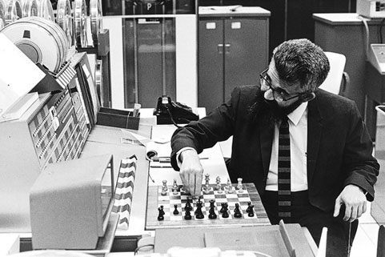
Inventor of LISP
LISt Processing (LISP) was developed in 1950s by John McCarthy
Due to his childhood respiratory problems, he began school a year late, skipped 3 grades and graduated two years earlier from high school.
In his application to CalTech he wrote a one-sentence statement of purpose: “I intend to be a professor of mathematics.”
He later became professors of Princeton University, Dartmouth, MIT, and Stanford.
In 1966, he hosted a series of computer chess matches carried out via telegraph against rivals in Soviet Union.
In 1970s he presented a paper on buying and selling by computer, prophesying what is now called e-commerce.
Turing Award 1971
In 1982 McCarthy originated the idea of the space fountain, a form of "space elevator", a tremendously tall tower extending up from the ground.
AlphaGo?

Slide 7
A Brief History of LISP and Scheme
Developed specifically for artificial intelligence applications
Inherited from
algebraic syntax of FORTRAN
symbol manipulation of Information Processing Language IPL
mathematics, lambda calculus (λ-calculus), recursion theory
McCarthy's own invention
Common LISP developed in 1980s
a large commercial product, including all possible features
try to be compatible to all existing versions, e.g., Zeta LISP, MacLISP, interLISP
try to merge SCHEME into LISP, but the attempt failed.
Common LISP was standardized by IEEE in 1992.
AI becomes extremely active again after the occurrence of cloud computing and big data

Slide 8
Scheme: A Dialect of LISP
Developed in 1975 at MIT AI Laboratory as a research and teaching language.
Based on LISP with Improvements, including
better scope rule
procedures (functions) as the first-class objects
removing of loops – solely rely on recursive procedure calls to express loops (pure LISP also removed loops)
IEEE Standard in 1989 (Common Lisp in 1992)
Lexical differences, e.g., (zerop x) in LISP versus (zero? x) in Scheme

Slide 9
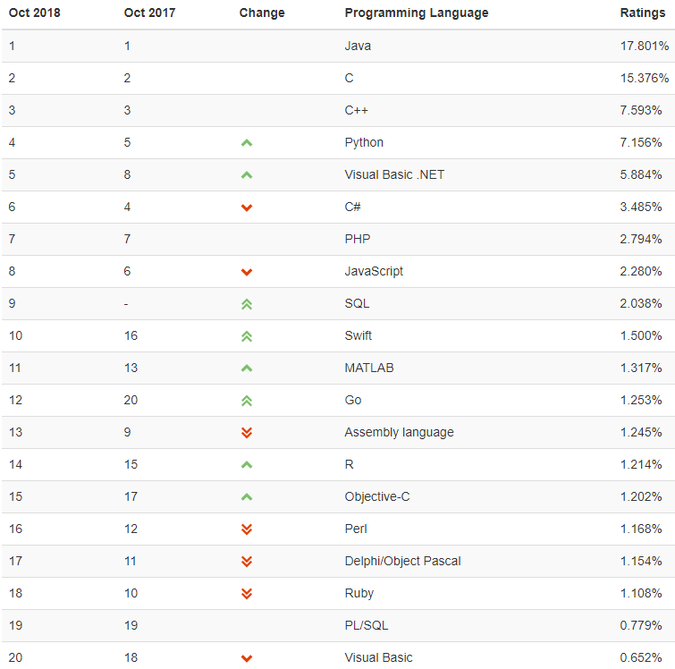
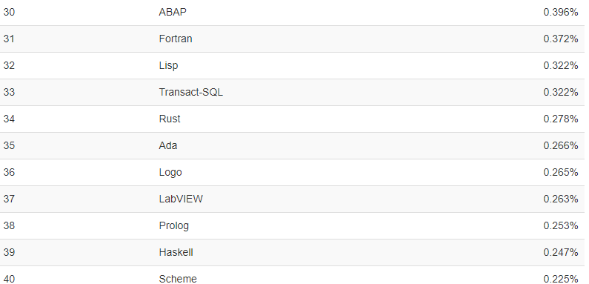
Programming Language Ranking History
http://www.tiobe.com/
Support functional programming and λ-expression
Source: http://www.tiobe.com/tiobe-index/

Slide 10
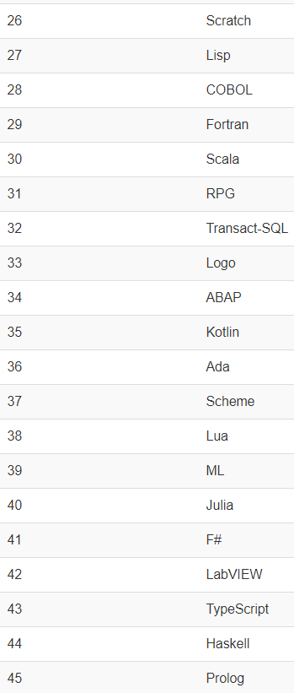
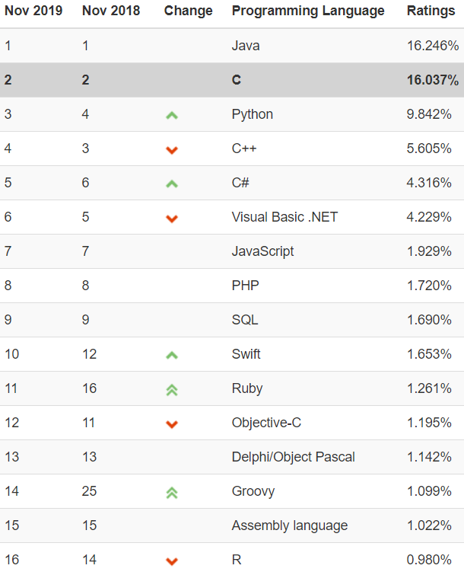
TIOBE Index for Nov 2019
http://www.tiobe.com/tiobe-index/
Oct 2018
Ranging

Slide 11

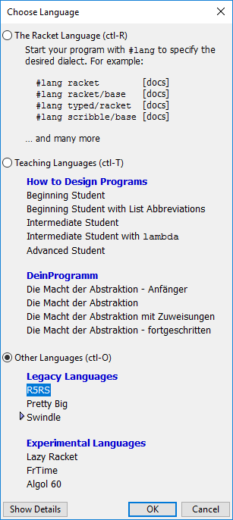
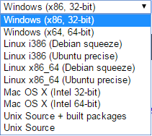
Getting Started
Download: http://racket-lang.org/download/
Download: DrRacket Scheme, the latest version.
When install: Right-click to run as administrator
If short cut not created, go to Program Files → Racket → start
After starting: Choose Language – Default does not work.
You must choose – R5RS, which is a professional edition.
Notice that the book is based on R5RS (professional edition). If you choose the Advanced Student version, many features, such as the pair data structure and its operations are not supported

Slide 12
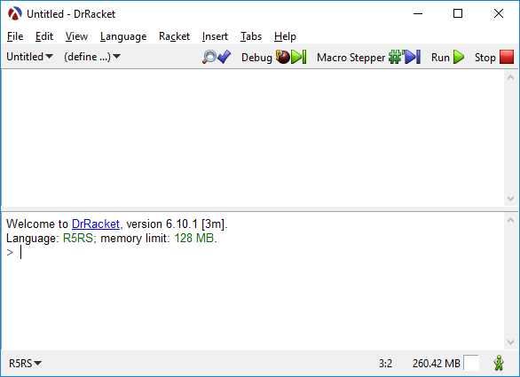



Start Your First Program
After you start the Scheme program, you will have two windows:
Type the program here
Do not copy and paste code from PPT directly.
Paste into Notepad first to remove the format, and then paste into here.

Slide 13
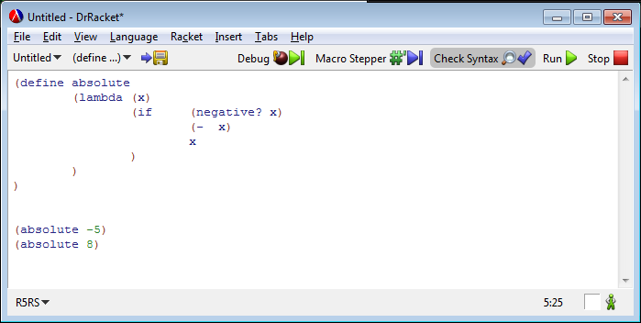

DrRacket Scheme Programming Environment with Debugging Support

Slide 14
Getting Started: Examples
Symbol
(quote x) or 'x ; x is a symbol using an apostrophe
→ 'x
(symbol? 'James) ; 'James is a symbol
→ true (#t)
(symbol? 5) ; 5 is a number, not a symbol
false (#f)
List and Operation
'(+ 3 1 2 3 7) (+ 3 1 2 3 7)
→ (+ 3 1 2 3 7) → 16
'(+ 3 1 2 3 7) is not a symbol. It is a constant list (literal).
(length '(+ 3 x 2 3 7)) (= 35 35) → true
→ 6 (eq? 'James 'James) → true
(length (3 x 2 3 7)) → ? (equal? '(1 5 3) '(1 5 3)) → true
Scheme uses Prefix Notation: Operator before operands.

Slide 15
Getting Started: More Examples
(member 2 (quote (1 7 3)))
→ false
(member 2 '(3 1 2 3 7))
→ (2 3 7), which is true.
(member '2 '(1 2 3)) ;'2 is converted to 2
→ true
(= 2 '2) ; '2 is converted to 2
→ true
(member '2 '('1 '2 '3)) ; '2 is not converted in list
→ false
(list '1 '2 '3 '5)
→ (list 1 2 3 5)
(member '2 (list '1 '2 '3 '5))
→ true

Slide 16
Notations of Expressions
Notation of
(x*(a*b + c))
Print the tree in postorder:
xab*c+* {postfix notation}
Print the tree in preorder:
*x+*abc {prefix notation}
Print the tree in inorder:
x*a*b + c {infix notation}
(x*(a*b + c))
Expression Tree

Slide 17
Prefix Notation and Evaluation
infix prefix prefix-p postfix
3 + 4 + 5 + 3 4 5 (+ 3 4 5) 3 4 5 +
3 + 4 * 5 + 3 * 4 5 (+ 3 (* 4 5)) 3 4 5 * +
(3 + 4) * 5 * + 3 4 5 (* (+ 3 4) 5) 3 4 + 5 *
The rules of adding parentheses in the prefix notation
Add an open parenthesis before each operator;
Add a close parenthesis after the last operand of the operation.
Both Scheme and LISP apply these rules!

Slide 18
Basic Data Types
Number: include integer and float, e.g., 2, -5, 1.03, 2.5e-3, 3/4
String: sequences of characters enclosed in double quotes, e.g., "Hello world!" and "(* 3 5) = 15 is a string"
Symbol: a single quote (apostrophe) followed by a word: 'Jim
List: a list of elements of any type: '(3 5 5 Hi Jim (5 9) "Hello")
What are differences between "James" and 'James ?
A string can be processed, but a symbol cannot!
(string-length "James") ⇒ 5
(string-length 'James) ⇒ error, string type expected.
(symbol-length 'James) ⇒ error, function does not exist
(symbol? 'James) ⇒ true (string? 'James) ⇒ false
(symbol? 'Ja mes) ⇒ error (string? "Ja mes") ⇒ true

Slide 19
Terminology
Primitives: The set of predefined operations that Scheme is build on. These operations cannot be defined in terms of anything simpler. For examples
(+ 3 6), (<= 2 5), (sqrt 32), (number? 4.5), (symbol? "x")
Form: Anything you ask Scheme to evaluate is a form. The answer to a form is the value of the form.
(+ 3 6), (+ (* 4 6) 9)
Procedure: a new "primitive" created using define keyword. It returns a value when it is evaluated.
Function: In Scheme, there is no function (function is used in its general meaning only, say, a mathematical function). A procedure in Scheme has the same meaning as the function in C.

Slide 20
Terminology (contd.)
define: It associates (binds) a form to a name. Three parts:
1) The keyword define (define max 100)
2) The name to be defined
3) Any form that gives a value.
define can be used to create a new name or procedure (operation) that does not exist in the set of primitives.
lambda: keyword used to define a procedure.
Argument: The input values that a form needs for performing the evaluation (actual parameter in C).
Parameter: names used when you define a procedure. Parameters will be replaced by arguments when they are evaluated (formal parameter in C).

Slide 21
Terminology (contd.)
Application: Applying an operation to the results of evaluating the other forms, e.g.,
(operation form form ... form) is an application.
The forms are the parameters of the application. According to the definition of forms, an application is a form too. A primitive is not considered as an application
define procedures (parameters, forms)
define syntax (parameters, forms)
macro
Scheme
Program
primitives (operator, values)
forms
(operator, forms)
procedure calls
macro calls
applications

Slide 22
first
Basic Scheme Procedures -- Lists
(car lst) returns the first element of the list lst
e.g., (car '(5 3 1 2 3)) → 5
(cdr lst) returns the remaining list without the first
e.g., (cdr '(5 3 1 2 3)) → (3 1 2 3)
CAR: Content of Address Register. CDR: Content of Decrement Register in IBM704
(equal? a b) if a = b, returns true, otherwise, returns false. It applies to numbers. (eq? x y) and (equal? x y)
(list a b c) returns a list (a b c), e.g., (list '(1 2 3) '(5 6)) → ((1 2 3) (5 6))
(append a b) appends b to a e.g., (append '(1 2 3) '(5 6)) → (1 2 3 5 6)
(member a b) if a is an element of list b, returns true, otherwise, returns false.
e.g., (member 5 '(3 7 5 6)) → (5 6), which is considered true.
rest

Slide 23
Basic Scheme Procedures (contd.)
(if c a b) if the value of c is #t, returns a, otherwise, returns b.
e.g., (if (= x 0) (+ a1 a2) (- b1 b2)))
(remainder a b): returns the remainder of a/b
(quotient a b): returns the quotient of a/b
(length L): number of elements in list L, e.g., (length '(2 '5 'a 23.9 "abs" '(2 3))) returns 6
(expt x y): returns the value of x^{y}
(integer? a) or (number? a): returns true if a is an integer or a number
(>= a b) or (<= a b)
(null? L) returns true if L is an empty list: '()
Efficiency issue:
Which is more efficient: (null? L) or (= (length L) 0) ?

Slide 24
Examples of Nested Operations
x = GetData(...) (PrintResult
x = ProccessData(x) (ProcessData
PrintResult(x) (GetData(...))))
Find the third element in the given list '(3 1 8 9 2)
x = '(3 1 8 9 2)
x = cdr (x)
x = cdr (x)
x = car (x)
(car (cdr (cdr '(3 1 8 9 2))))
(caddr '(3 1 8 9 2))
Find the smallest number in lst = '(3 1 8 9)
(define lst '(3 1 8 9))
(min (min (car lst) (cadr lst)) ; assume (min x y) is defined
(min (caddr lst) (cadddr lst))
)

Slide 25
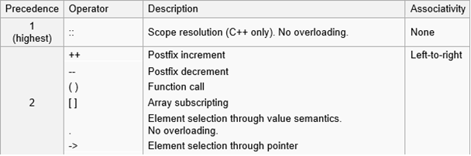
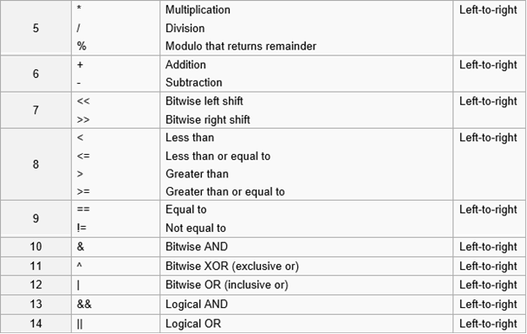
Order of Evaluation in C/C++: Text Section 2.2.1
For C/C++, at the same level of precedence:
a + b + c + d
For Scheme, at the same level of precedence, the order does not matter

Slide 26
Order of Evaluation and Parallel Computing
Definition (Textbook, Section 4.3):
Eager evaluation: Evaluate everything that can be evaluated.
Innermost first;
Evaluate all arguments of a procedure first.
Lazy evaluation: Evaluate only those that are needed.
Outermost first;
Evaluate arguments of a procedure only if their values are needed.
Imperative programming requires of using lazy evaluation only. Functional programs guarantee that the same result will be produced no matter what order is used. It is more friendly for parallel computing
Example 1:
(+ (+ 3 5) (* (+ 4 6) (- 5 3)))
(1) (+ 4 6), (- 5 3), (+ 3 5),
(* 10 2), (+ 8 20)
(2) (+ 3 5), (+ 4 6), (- 5 3),
(* 10 2), (+ 8 20)
Example 2: (if c(x) a(y) b(z))
c, a, b, if
c, if, a; or c, if, b;
Which is better for parallel computing?
Assuming computing a, b, and c takes one hour each

